Slide 1
Relational Databases (Introduction lecture)
KC4000

Slide 2
Introduction
Overview of the course
Teaching team
Lectures – EJ
Seminars – Mark, EJ & Akhtar
How the module will run
Lectures –1 hours a week
Seminars - 1 hours a week
Self study - 5 hours a week
Assessment
covers Database principles & SQL Exam x 2
worth 50% each
At the end of each semester during the assessment period
Expectations of you
ATTEND! (Lectures AND seminars)
Make notes – the slides are there to keep me on track, they will not provide sufficient details for revision alone, make notes in class, write up after class then revise notes after seminar experiences. There is sound pedagogical reason for doing this!
Do the 5hrs study outside of class
I expect you to complete each set of seminar tasks BEFORE the following week & to recap what you have done

Slide 3
Terminology
Database: a collection of persistent and structured data
Database management systems (DBMS): software component that manages databases
Database system: Database + DMBS
Data: known facts that can be recorded and have an implicit meaning
Data model: set of concepts describing the structure of the database and constraints that a DB should obey
Conceptual semantic model: concepts that are close to the way users perceive data (aka entity bases or object based data models)
Physical model: concepts that describe how details are stored in the computer
Database schema: description of the database and its structure/constraints

Slide 4
What is a database?
A very large integrated collection of data
They model the real world (enterprise)
Entities in the system (staff, student, module, programme)
Relationships (a student is registered in a programme, a tutor lectures on a module)
Current models include active components modelling “business logic”
Program data independence (Insulation between program and data allows changing data storage structures and operations without having to change the DBMS access programs)
The Database Management System (DBMS)
Software system whose function is to store, manage and facilitate access to the data underlying the database and all associated objects within the database.

Slide 5
Changing nature of databases
File based
Networked
Hierarchical
Relational
Relational
Relational
Big Data
1968 to 1980 was known as the non-relational period
1980’s – 2010’s primarily relational databases were used
Recent decade Big data and alternative types increase in usage
Notes:
1968 File-Based data storage (predecessor of database)
Data maintained in a flat file.
Data are stored in files with interface between programs and files.
Mapping happens between logical files and physical file, one file corresponds to one or several programs
Requires extensive programming in third-generation language such as COBOL, BASIC.
Limitations:
Separation and isolation:
Each program maintains its own set of data,
users of one program may not aware of holding or blocking by other programs.
Duplication: Same data is held by different programs
High maintenance costs such as ensuing data consistency and controlling access
Sharing granularity is very coarse
Weak security
Hierarchical data model
Mid 1960’s Rockwell partnered with IBM and created the ‘Information Management System’ (IMS) which lead the mainframe market in the 70’s and early 80’s
Binary tree structure, logically represented by upside down tree
1 to n relationships between parent and child records
Efficient searching
Complex implementation
Hard to manage
lack of standards and lack of structural independence
Network data model
Charles Backmann developed the first DBMS in early 60’s
Standardised by ‘71
Very complex system, hard to design and maintain
Poor structural independence
Relational database 1970 – current time
Principle idea is to organise data in the form of 2 dimensional tables
Designed to need the informational needs for an organisation
Data abstraction allows view level, users access a logical view for query writing
1970 Ted Codd at IBM proposed relational model
1976: Peter Chen defined the Entity-relationship(ER) model
1980s relational database technology evolved, more relational based DBMS were developed and SQL standard adopted by ISO and ANSI.
1985: Object-oriented DBMS (OODBMS) develops.
Little success commercially
advantages did not justify the cost of converting billions of bytes of data to new format.
1990s: incorporation of object-orientation in relational DBMSs, new application areas, such as data warehousing and OLAP, web and Internet, Interest in text and multimedia, enterprise resource planning (ERP) and management resource planning (MRP)
1991: Microsoft ships Access, a personal DBMS created as element of Windows gradually supplanted all other personal DBMS products.
1995: First Internet database applications
1997: XML applied to database processing, major vendors begin to integrate XML into DBMS products.

Slide 6
Why study databases?
Corporate computing uses information, INFORMATION is based on interpretation of DATA
There is a shift from COMPUTATION to INFORMATION
Always true for corporate/business computers
Increasingly true for scientific computing
Need for DBMS has dramatically increased over the past few years
Corporate/business: retail swipe/click processes, CRM, supply chain management, data warehousing etc.
Scientific: digital libraries, Human Genome project, NASA mission to planet earth etc
DMBS encompasses much of computer systems
OS languages, AI, multimedia logic
But traditionally focuses on real-world apps.

Slide 7
Structural elements
Represents information through data modelling and models reality
Languages and systems for querying data
Complex queries with real relationships
Must generate correct answers!
Handles massive data sets
Deeply tied to models
Must support the evolution of the models,
Concurrency control for data manipulation
Ensures correct data in the face of concurrent update, how to maintain data validity without ‘one at a time’ operations
Ensures transactional run smoothly
Reliable data storage
Data structures are maintained even if the power goes.

Slide 8
Relational Structure
Users view the information that is extracted from data.
Users see the data that is relevant to them
SQL maps on to tables, views etc. (CONCEPTUAL)
Data is held on the disks (PHYSICAL) and access is controlled by the DBMS
Each user may see a different view of the database dependant on need.
The database model is used to hide the storage details and present users with a conceptual view of the database.
Users
View 1
View 2
View 3
Conceptual Schema
Physical Schema
DB

Slide 9
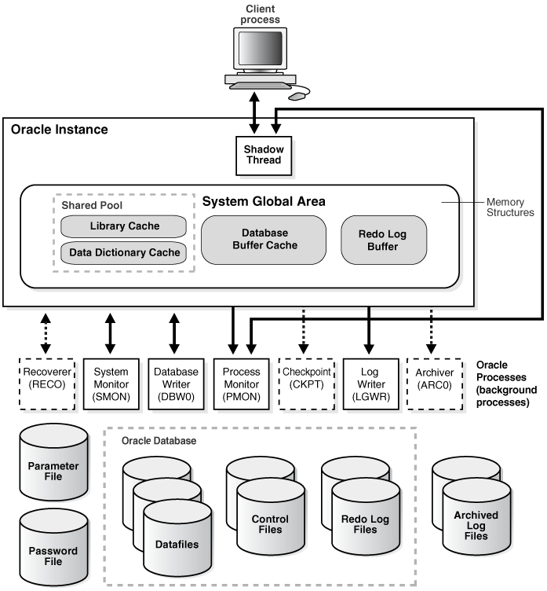
Structure of the Oracle DMBS
Users access the data via SQL commands or an application
Data files are stored on the physical location and contain the raw data
DBMS knows where the data is held and which blocks contain data from the specified tables
Retrieval is optimised by the DBMS

Slide 10
Advantages of a DBMS
Data independence
Efficient data access
Data integrity & security
Data administration
Concurrent access, crash recovery
Reduced application development time
When a DBMS is inappropriate:
Inhibitors:
Cost: Initial investments and need for additional hardware
Overhead for providing generality, security, concurrency control etc
DBMS may be unnecessary if:
DB and applications are simple, well defined and not likely to change
Stringent real-time requirements are not possible with the DBMS overhead
No need for multiple users and concurrent handling

Slide 11
Summary
Databases, DBA’s, database developers are the bedrock of the information economy
DMBS and relational databases represent a broad fundamental branch for computer science.
Database evolution and usage are coming full circle, a computer scientist or IT manager need to understand the trends and organisational needs to be able to plan for future proofing of systems.

